Slide 1
Norris Crescent Housing Co-operative Proposed Re-Development Update
Members Drop-in
May 25, 2022

Slide 2
It’s been a while since we last met...
We are here Tonight to:
Review where we left off
Meet Member Engagement Consultant, Brent Whitty
Discuss progress of proposed re-development and repair plans.
Show preliminary and proposed building design.
Discuss MOVING FORWARD and THE need for additional funding.

Slide 3
Where We Left Off...
Last Town Hall on January 22, 2020:
Reviewed current capital issues facing the co-op.
Discussed the options that had been presented to the board, which included the removal of two buildings (7 & 9) , possible sale of another (24) and the building of a new building to replace 7 & 9.
Members voted and approved TWC to apply for CMHC SEED Funding to acquire architectural and planning services as well as initiate some engineering studies.
Commitment was made in 2020 and still stands: NO final decisions would be made without member consultation and approval. And NO members would be left without a home as a result of proposed redevelopment.
It is understood that this is a complex initiative that requires considerable member and community involvement.

Slide 4
Member Engagement - Meet Brent Whitty
TWC is pleased to introduce Brent Whitty who is working as the Member Engagement Consultant on this project.
Brent is passionate about affordable housing and has an extensive background working with co-ops developing new housing and most recently as the Manager, Housing Programs at the Ministry of Municipal Affairs and Housing.
Brent’s mandate is to work with members, the board and the development sub-committee on ensuring there is a clear understanding and communication process related to the proposed re-development.
Brent is here to listen, provide information, guidance and feedback and will be working closely with you and the development sub-committee.

Slide 5
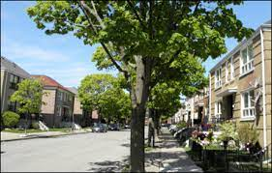
NORRIS CO-OP: ENGAGEMENT PRINCIPLES
Norris Co-op provides affordable housing to its members and the community.
Norris Co-op is a close community that cares about its members.
It is important that Norris Co-op continues to operate as a viable co-op into the future.
Members must be part of the planning and visioning process to ensure these things can continue.

Slide 6
Where Are We Now? Progress to Date
Since we last met, Co-op approved for some funding!
CMHC SEED Funding ($39,000 Grant, $76,000 Loan) was obtained to undertake some required studies.
CMHC Funding ($26,000 Grant) received to complete Building Condition Audit and Reserve Fund, Energy and Ageing in Place Studies.
City of Toronto Open Door Funding ($50,000 Grant) approved to undertake required studies.
Community Housing Transformation Centre ($44,500 Grant) to assist with member, board and community consultation and capacity building (Brent’s work).
Pending – Co-operators Insurance ($20,000 Grant) for required studies.

Slide 7
Where Are We Now? Progress to Date
We are getting organized!
A Development Sub-Committee of the Board has been established and meetings are being held on a regular basis.
A Terms of Reference has been established. A review of Development Process has occurred. Lots more work is ahead, and more members are welcome to attend committee meetings.
IRC has recently completed the updated building condition audit and reserve fund study. These reports are under currently under review.
Some engineering studies are underway (but there are more).
And we have preliminary building designs....

Slide 8
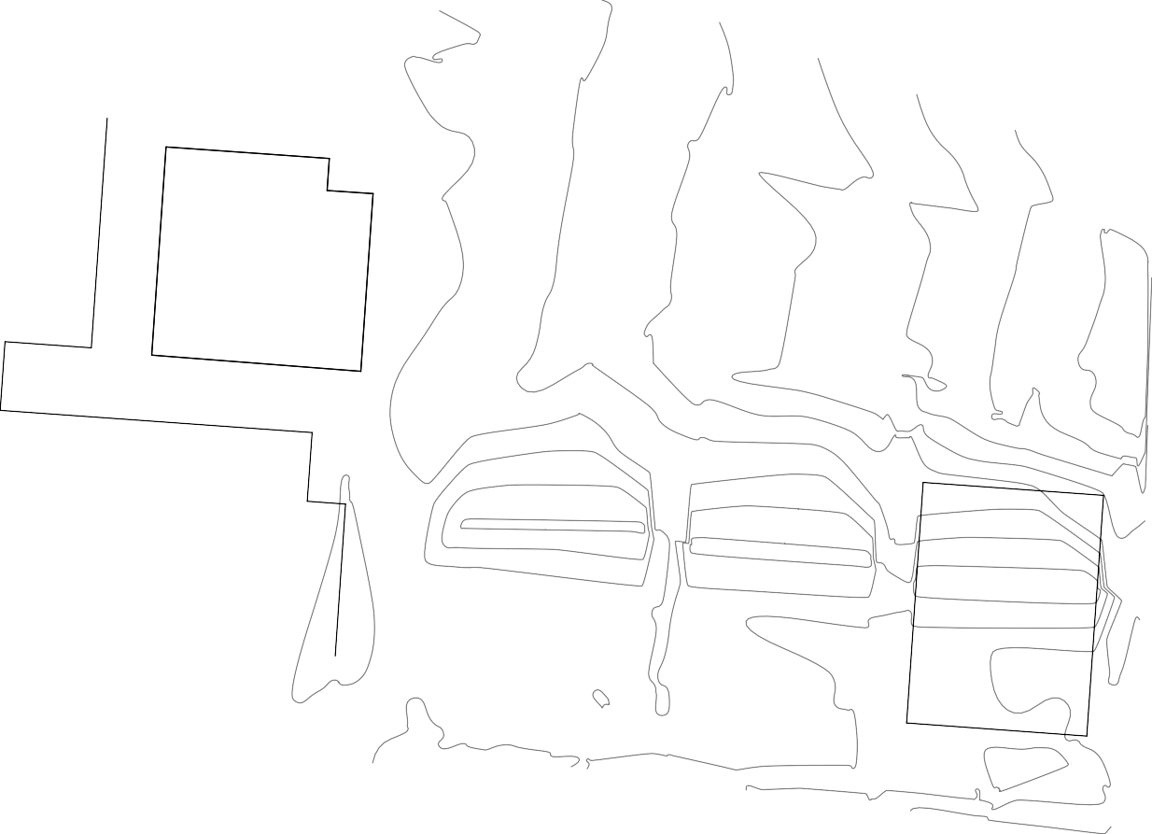
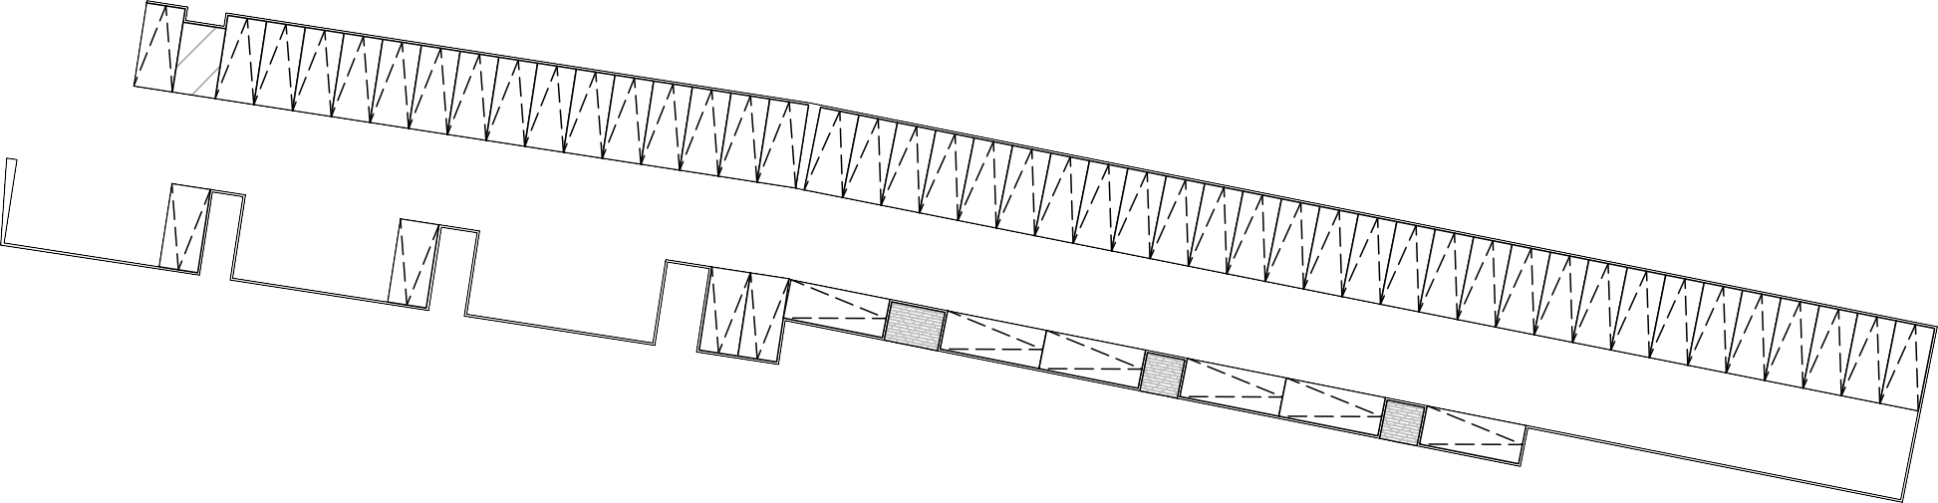


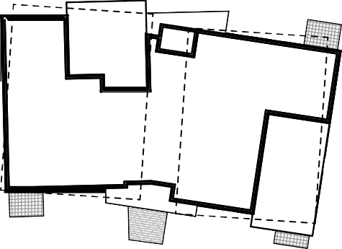
















utdoor Parking Spaces:
Ex st : 61
roposed: 6
N° 2515
3 STOREY
BRICK
A ARTMENT
BUILDING
14 STOREY
BRICK
A s p h a l t
BUILDING
6 STOREY
N° 251
STUCCO
4 STOREY
BUILDING
BRICK
BUILDING
1
5
ar ^{Spa es}
Co rete
CBW
CONCRETE
15
CBW
& BRICK
11
1 STOREY BRICK
GARAGE
Asphalt Dr veway a d ar Area
ar
Co rete
Blo
Wall
5
5
ar
Spa es
Dr ve A sle
Spa es
29
2
Type G Load Spa e
T mber
5
Co rete
Curb
5 ar
Spa es
4
2 ar Spa es
Co rete Blo
T mber Curb
1 ar Spa e
3
1 ar Spa e
ar
Wall
T mber Curb
T mber Curb
T mber
1 ar Spa e
2
1 ar Spa e
Curb
T mber
1 ar Spa e
1 ar Spa e
Dr ve A sle
Co . Curb
Curb
2
^{T mber} Curb
T mber
Curb
Spa es
Co .
N° 251
2 STOREY
Asphalt
Asphalt
1
T mber
T mber Curb
Co rete Wall
4 STOREY
BRICK
BUILDING
C.L.
BRICK
Asphalt
DWELLING
Curb
S
Asphalt
at o
2 STOREY
Asphalt
at o
Co rete
N°
BRICK
Co rete
Asphalt
DWELLING
2 STOREY
N° 9
BRICK
DWELLING
2 STOREY
Asphalt
Asphalt
Co rete
N° 11
BRICK
Asphalt
DWELLING
Co rete
2 STOREY
N° 15
BRICK
Co rete
DWELLING
WINDOW
2 STOREY
Asphalt
N° 1
WELL
BRICK
DWELLING
2 STOREY
CSW
EOA
C.L.
WINDOW
N° 19
BRICK
Asphalt
CSW
Co rete
WELL
DWELLING
2 STOREY
F.L.
La d
C.L.
Co rete
N° 21
BRICK
0.59 E
CSW
DWELLING
2 STOREY
N° 23
BRICK
CSW
C.L.
Asphalt
DWELLING
Approx mate
Ce trel e of aveme t
I terlo
Br
C.L.
Co rete
N° 25
C.L.
C.L.
Br
I terlo
CSW
C.L.
NORRIS
CRESCENT
Co rete Curb
Br
Proposed Site Layout
I terlo
Co rete Curb
CSW
Br
Co rete
Ro
SK-0.2
a king lan
Concept Sketch for:
Hi/ditch Architect Inc.
Proposed Co-Op Housing: Scheme B
01 Richmond Street West, Suite 13
Date:
ro ect o: Scale:
Sept, 2020
20
:500
7 & 9 Norris Crescent
Toronto, Ontario MSV 3A
t 1 1 0 www.hilditch architect.com

Slide 9
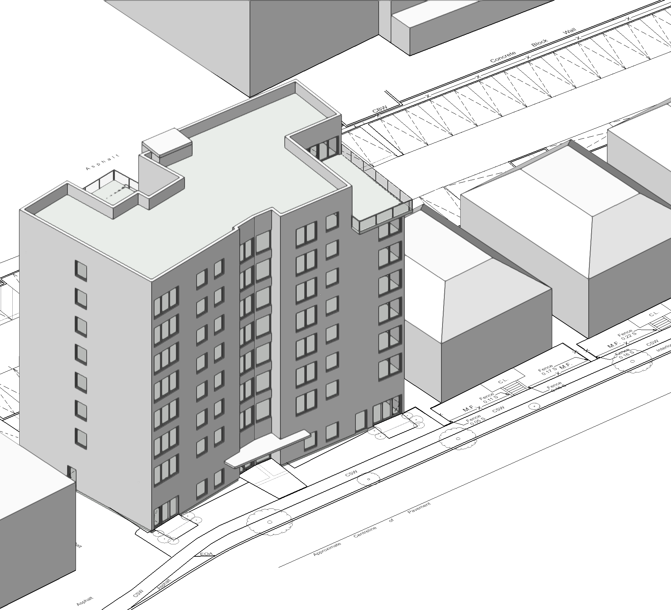
Proposed New Norris Co-op Building Design
43 units.
Mix of 1, 2 and 3 bedrooms, including accessible units.
Individual heat and air conditioning controls.
Amenity spaces include:
Onsite laundry room.
Meeting space.
Proposed rooftop outdoor space.
Built to high energy efficiency and low environmental impact standards.

Slide 10



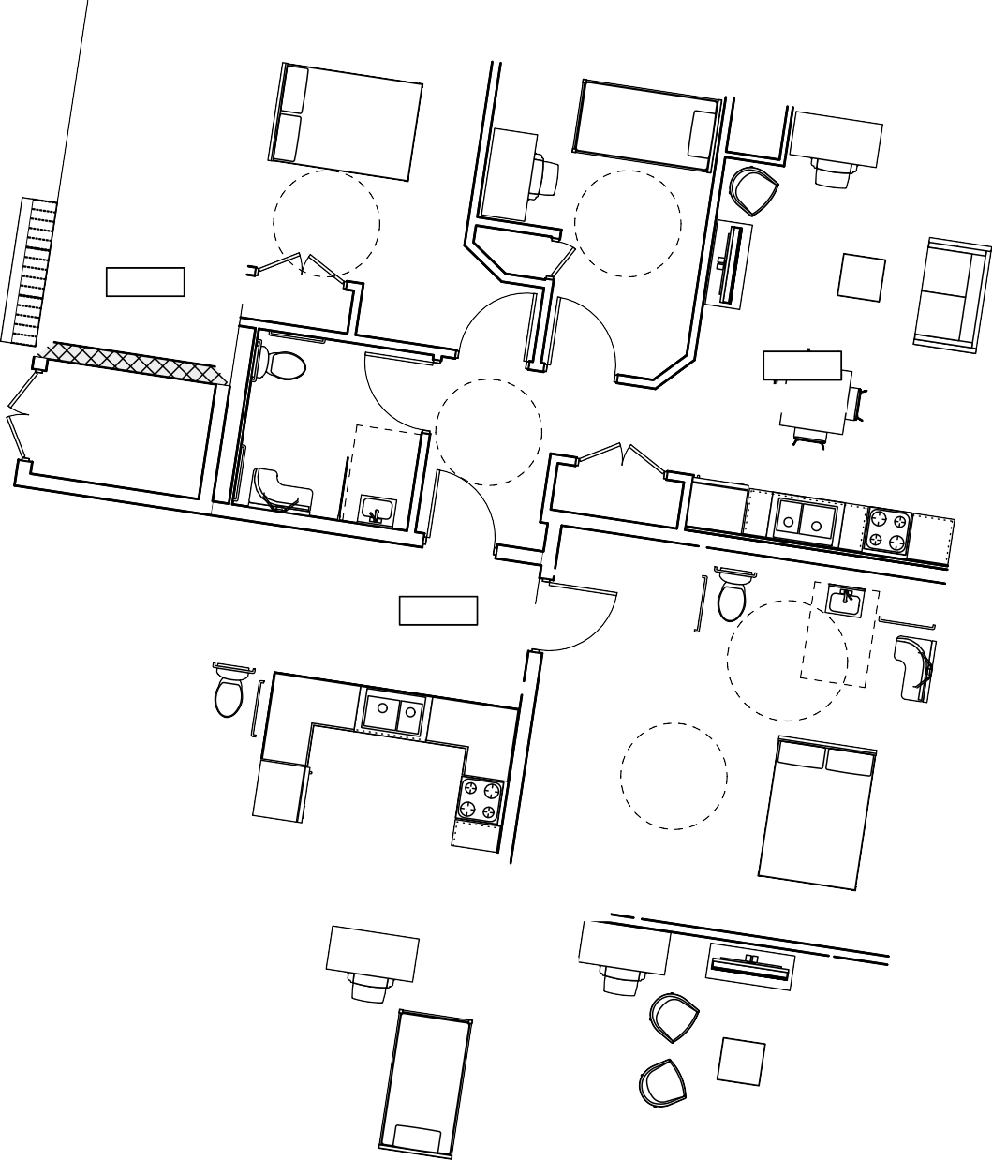














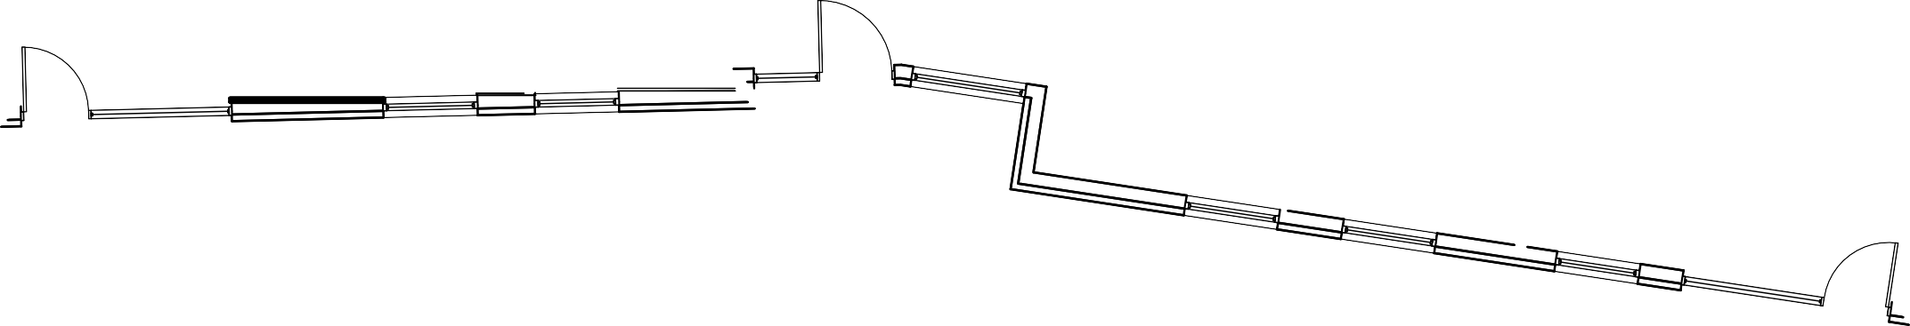





33
Canopy above
T
4000
Elevator
M&E
120
110
Garba e
5.9 sq m
20.5 sq m
109
31.9 sq m
Ve tical ike Sto age
Adm
Mail
ockboxes
Sta r B
100-B
10
13 sq m
B e ar
10.6 sq m
Su te - 2 Bed
102
Asphalt
108
Corr dor / Lobby
1 sq m
Asphalt
25 sq m
2 STOREY
104
BRICK
43.6 sq m
DWELLING
Sta r A
Corr dor
106
13.8 sq m
100-A
2
STOREY
Su te - 2 Bed
N°
12.5 sq m
BRICK
101
6 .3 sq m
DWELLING
Vest bule
105
19.1 sq m
N° 9
Su te - 3 Bed
103
Co rete
99.6 sq m
Canopy above
SK-1
o n Floo lan
Hi/ditch Architect Inc.
01 Richmond Street West, Suite 13 Toronto, Ontario MSV 3A
t 1 1 0 www.hilditch architect.com
Ground Floor
Date:
ro ect o: Scale:
Sept, 2020
20
: 00

Slide 11

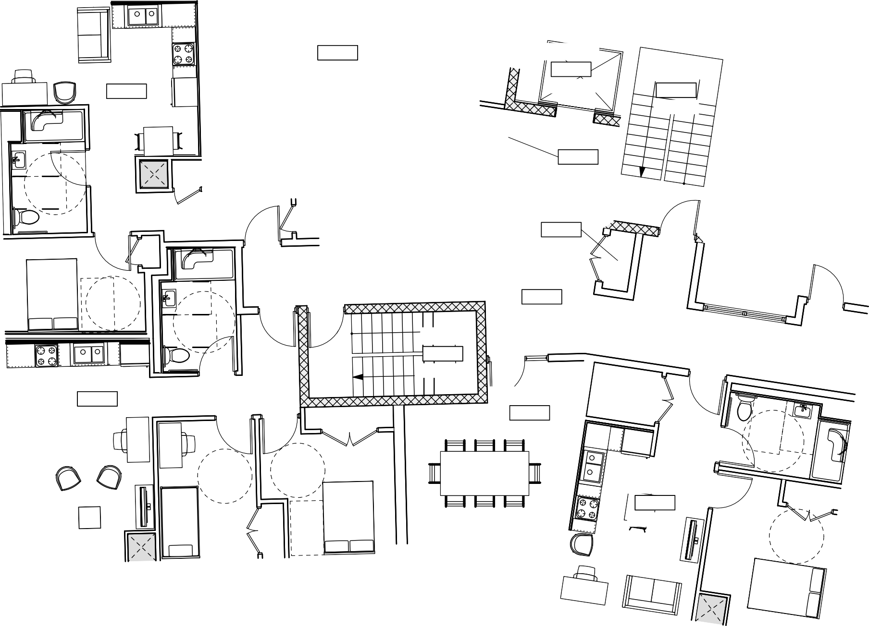


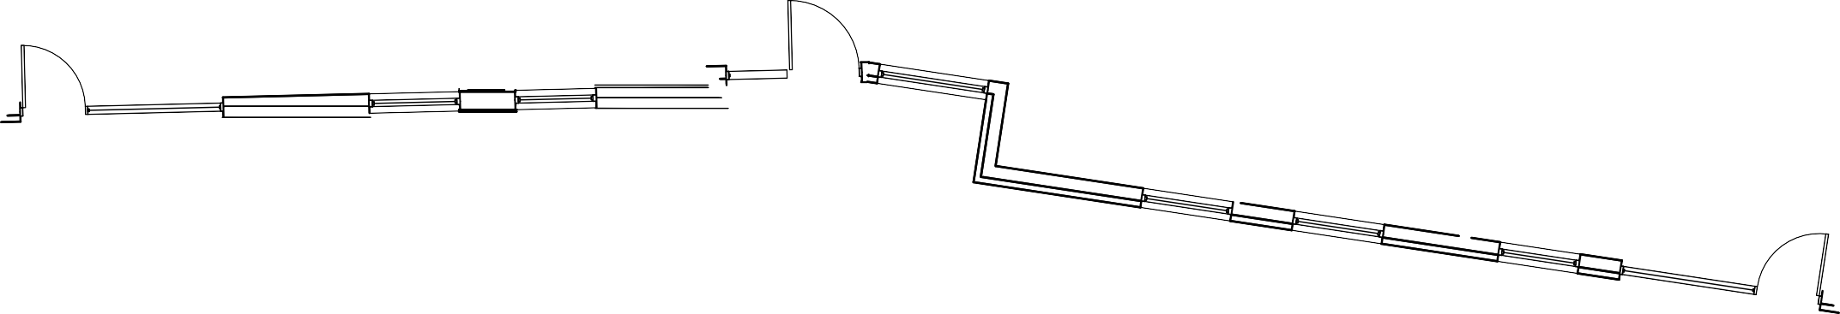

Canopy below
T
Outdoor Ame ty
810
53.4 sq m
Elevator
811
.3 sq m
Su te - 1 Bed
802
54.4 sq m
Sta r B
X00-B
13 sq m
Garba e
805
3.2 sq m
I door Ame ty
Ele . Closet
806
1. sq m
808
6 .4 sq m
Asphalt
Asphalt
2 STOREY
Lobby
804
51. sq m
BRICK
DWELLING
Sta r A
800-A
10.8 sq m
N°
2 STOREY
Su te - 2 Bed
801
1.2 sq m
Meet Rm
80
22.9 sq m
BRICK
DWELLING
N° 9
Su te - 1 Bed
803
48.5 sq m
Outdoor Ame ty
809
59.6 sq m
Co rete
Canopy below
SK-
Concept Sketch for:
Hi/ditch Architect Inc.
ighth Floo lan
8th Floor
01 Richmond Street West, Suite 13 Toronto, Ontario MSV 3A
t 1 1 0 www.hilditch architect.com
Date:
ro ect o: Scale:
Sept, 2020
20
: 00

Slide 12
How Do We Move Forward?
Zoning and Site Plan Approvals from City of Toronto
Need to undertake several additional professional and engineering studies and submit them to the city for planning approvals.
Do not have enough funding to pay for the studies. May require up to approximately $250K to get to the building permit stage.
Will take several months to complete.
Norris Co-op requires a small, short-term loan to pay for the remaining required work.
Could use the $76,000 interest free loan from CMHC.
A lender – Community Forward Fund could loan the rest of the funds.
Loans would be paid out once CMHC Co-Investment construction financing is approved and provided.
There is some risk to the Co-op if loans is taken out and the project does not proceed, however, this is not expected.
Members are required to approve use of CMHC loan and taking out CFF loan – without it, we cannot continue, and the project will stall.

Slide 13
How Do We Move Forward?
City of Toronto approvals will be required for Zoning By-Law amendment and Site Plan – apply this fall, with approval likely early next year.
An application will be submitted (later this year) for Open Door capital funding from the city.
Plans will be developed for the possible temporary relocation of impacted members. We will work closely with the members on this.
We need your ideas! We will be reaching out to you for your thoughts and ideas.
Project schedule will be become clear in the coming weeks as more studies are completed and more discussions with the city occurs. A project plan will be developed and provided to members.
THE BOARD AND MEMBERS WILL BE CONSULTED TO HELP MAKE IMPORTANT DECISIONS

Slide 14
Now it is your turn...
A comment sheet and pens are available. We would like your thoughts on what you heard tonight.
New! You can always send your thoughts and ideas to norrisredev@gmail.com. This email address should only be used for thoughts related to the new proposed development.
COMING SOON! A new section will be added to the Norris Co-op website providing members with updates and information related to the redevelopment project.

